Slide 1
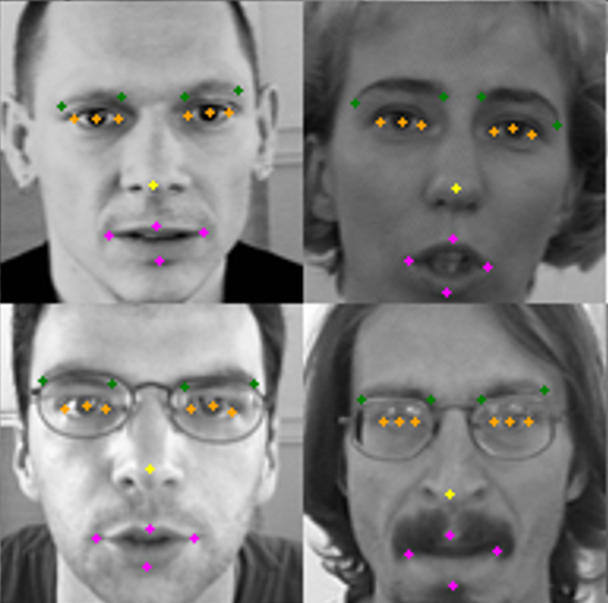
Facial Keypoints Detection
Ed Brown
Ray Cao
Oscar Garcia

Slide 2
Contents
Answers to Remaining Baseline Questions
Models
Final results and Kaggle ranking
Improvements and future work

Slide 3
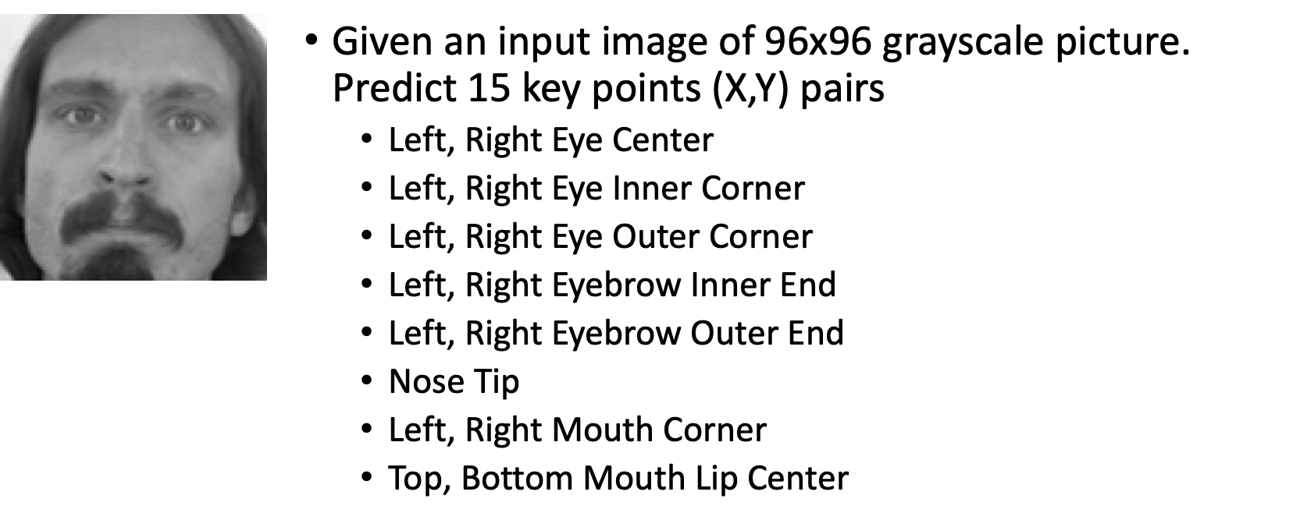
Kaggle Facial Keypoints Detection

Slide 4
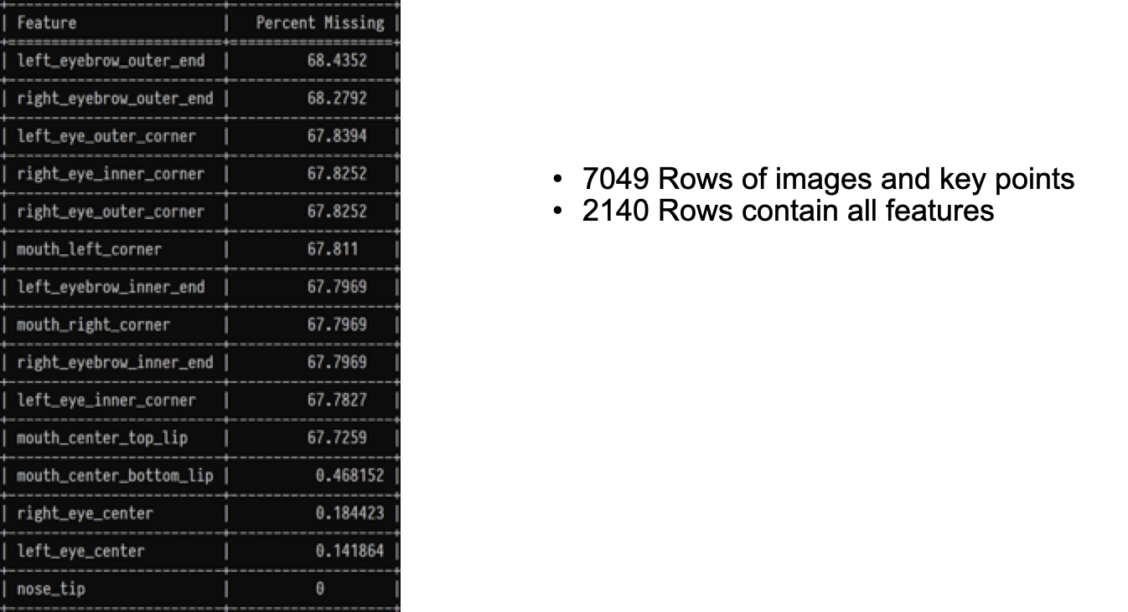
Missing Values

Slide 5
Answers to Remaining Baseline Questions

Slide 6
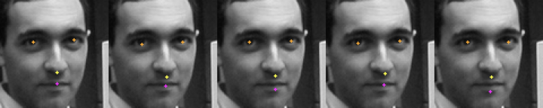
Duplicates in training set
Duplicate Images with differently labeled key points.
Leave them in place and let the model predict with them

Slide 7
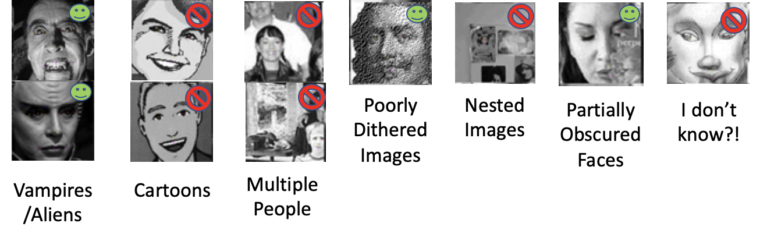
Outliers in training set
Choose to do automatic outlier removal rather than hand classify each image. Used three criteria:
Eye Center X Distance Less Than Twenty (Removed 38 Images)
Attempt to remove multiple people and composite images
Number of Gray Levels Less Than 110 (Removed 22 Images)
Remove cartoons or low resolution images
Number of Pixels with Same Color Greater than 1600 (Removed 21 Images)
Remove cartoons or low resolution images

Slide 8
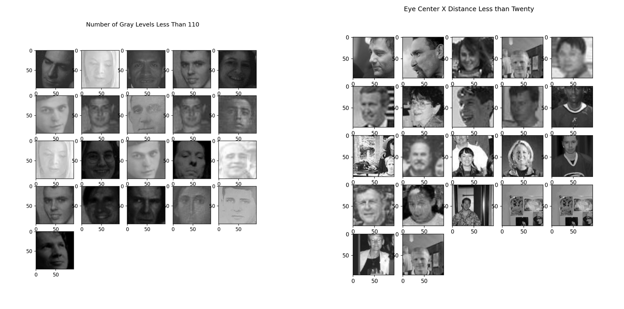
Outliers

Slide 9
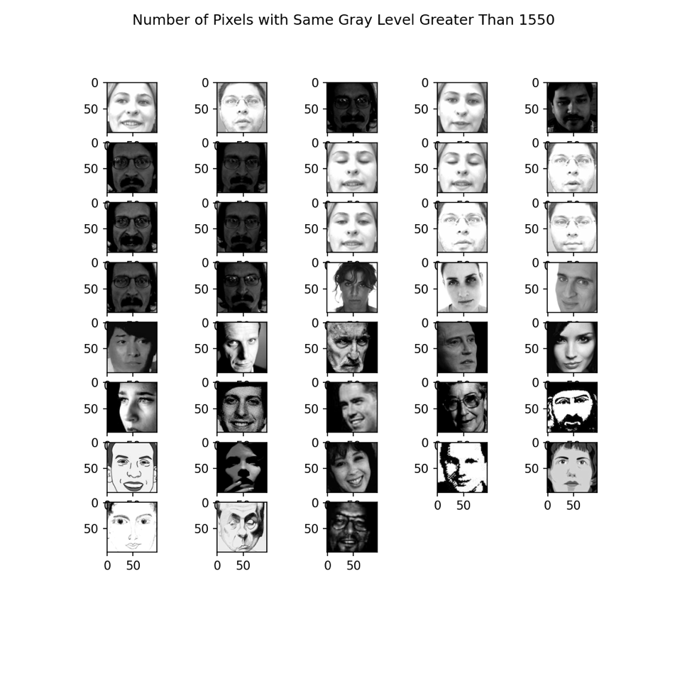
Outliers

Slide 10
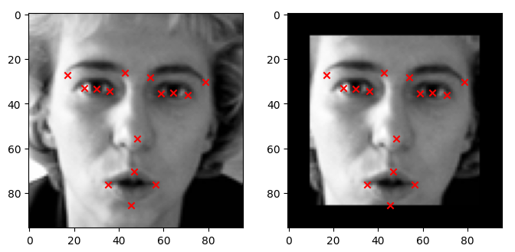
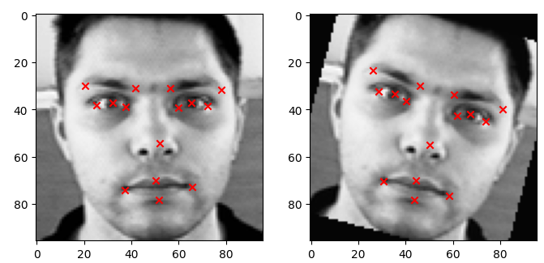
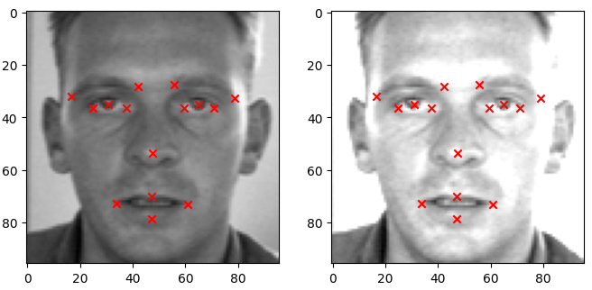
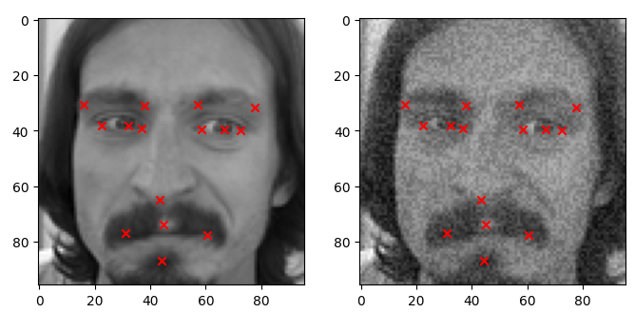
Data Augmentation
Having more training data can improve performance issues caused by overfitting
Generating our own images for training is more cost effective than collecting manually more real pictures
Only rotation showed a modest performance improvement (RMSE reduction by 5% approx.)
CROPPING
ROTATING
BRIGHTNESS
ADDING NOISE

Slide 11
Models

Slide 12
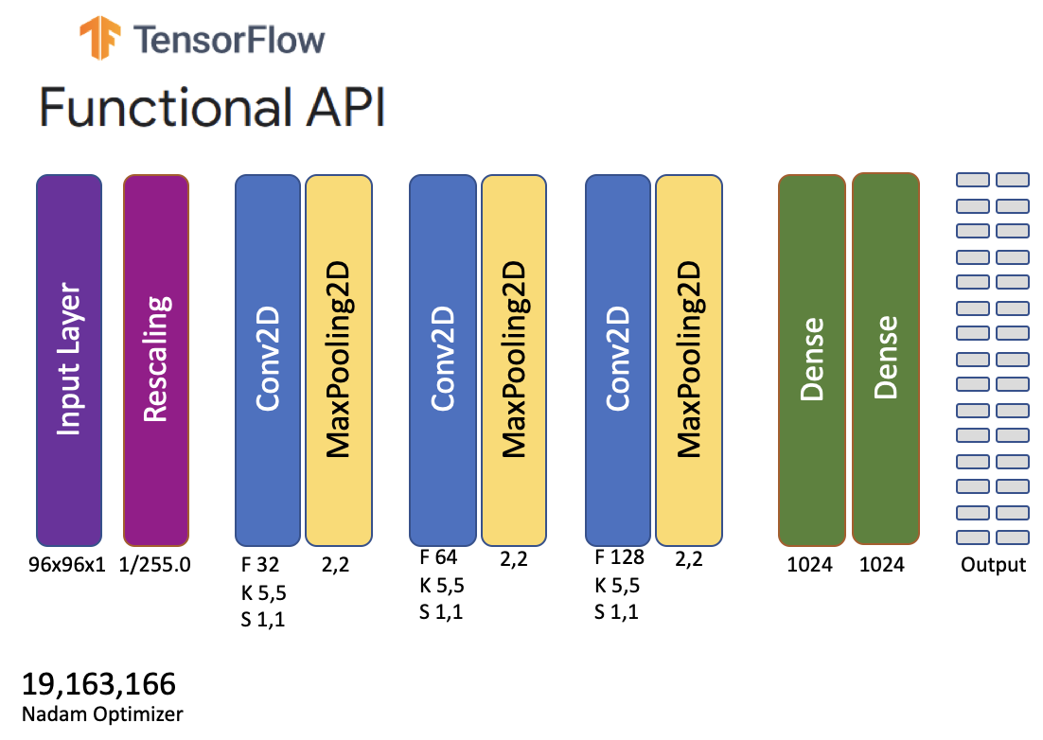
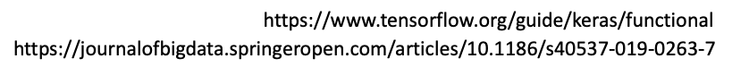
Example of Initial Designs For Joint Model
Notes:
1.We used the functional API since we didn’t know how the model would come together, advantageous for monitoring individual output loss but wasn’t required
2.Seems like a convolutional network would be a good place to start what did we do in Homework 10. J
3.Fit the Input Layer to the Image size, 96,96 rather than something larger 224,224,3. To make it quicker to train
4.How many layers? What kind of Kernel Sizes? What about Strides and Filters? Let’s take a guess.
5.How may epochs. Holy Cow no idea. Guess we’ll start with a 1000 Epochs was way too many and the model was very overtrained.
6.Notice there are no Batch Normalizations or Dropouts We’ll get to those later
7.In order to get started we’ll build a model that only takes 2140 images which have values for all key points and build and optimize a model from that

Slide 13
Results from Initial Designs For Joint Model
Generated five model designs in the initial development phase.
They were all overfit (expected)
1000 Epochs Takes a really long time!
CPU: 13s/epoch (3.6 Hours)
GPU: 1s/epoch (16.3 mins)
Validation Loss (MSE) could be better ~80 for all 30 outputs
We can’t recover the best weights for the model since we train for a fixed number of epochs.
Notes:
There were approximately five initial generation models. This slide summarizes all of them
Lot’s of times we’d just Ctrl C the models around 100 epochs when they weren’t looking good.

Slide 14
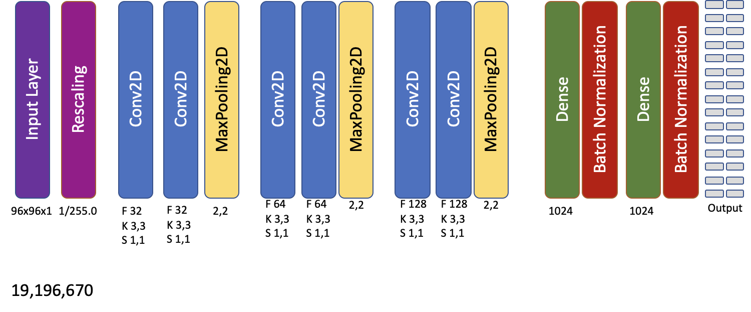
Intermediate Designs For Joint Model
Notes:
1.Experiment with Dropout and Batch Normalization to prevent overfitting.
1.Several Experiments Failed since Dropout layers were placed after maxpooling layers instead of after convolutional layers
2.Experiment with Stacking Multiple Convolutional Layers before Max Pooling Layers
1.Two Convolutional Layers Before Max Pooling Appears to be the Best Result
2.Stacking of three of these layers appears to provide best results.
3.Experiment with number and size of output layers.
1.Optimal Size of Output Layers appears to be between 1024 and 2048
2.No more than Two Dense Layers.
4.Experiment with Filter Sizes Strides and Kernel Sizes
1.For image size of 96,96 Optimal Initial filter size of 32
2.No more than 256 output filters in the final convolutional layers.
3.Kernel size of 3,3 appears to work best. Avoid Even sized Kernels they’re not symmetrical around the output pixel
4.Stride of 1,1 also appears to give best results. Let’s stick with these

Slide 15
Results: Intermediate Designs For Joint Model
Generated around fifteen model designs in the intermediate development phase.
Early stopping with restore weights is working properly
Validation Loss (MSE) improved to ~65 for all 30 outputs
Number of Training Epochs reduced to ~400
Submission to Kaggle.
Intermediate Model Results in 55th place on Kaggle Leaderboard
Notes:
2.82 and 2.93, 55th

Slide 16
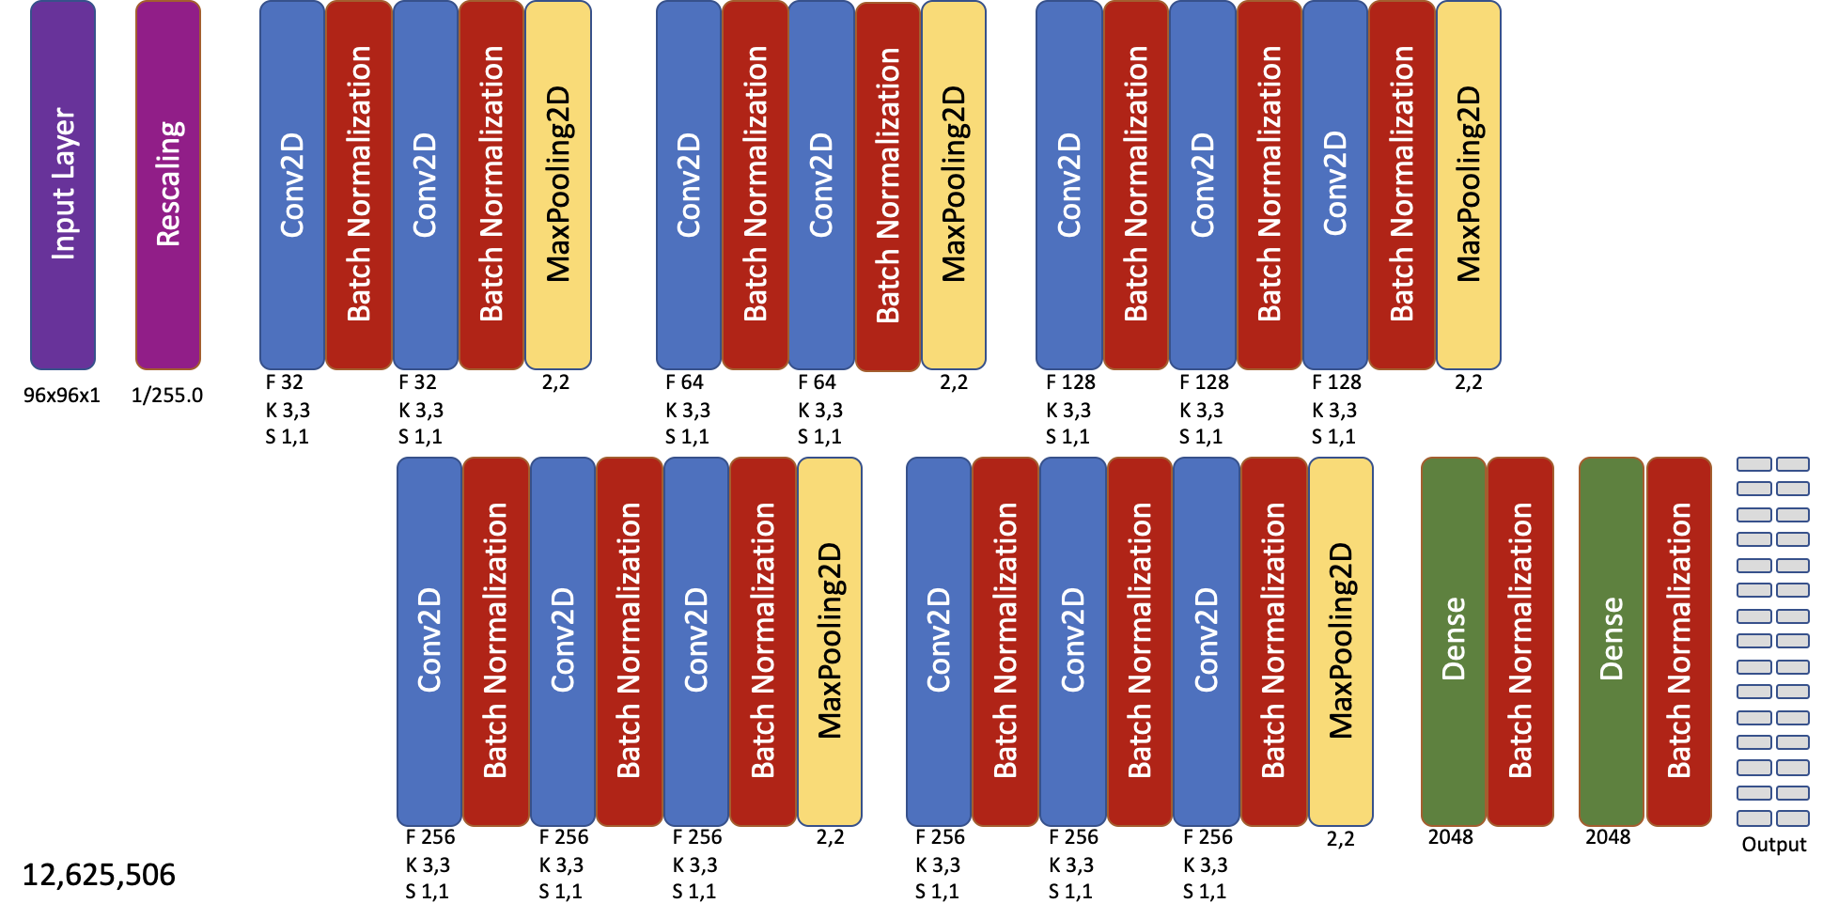
Final Design For Joint Model
Notes:
Review Existing CNN Architectures for Image Classification.
•Resnet 50
•Resnet 101
•VGG-16
•VGG-19
Notice that Our Intermediate Architecture is very similar to the VGG architectures.
•Code up both VGG19 and VGG16 Architectures with our input size 96x96x1
•Using the Original Number of Filters and Dense Layers Specified in the VGG Architecture. Whose input is 224,224,3
•Two choices, Upscale our images to 224,224,1 or cut down filters and dense layer to be smaller Chose the latter
•
•Evaluated both full parameter and cut down versions of VGG16 and VGG19 networks.
•VGG16 and VGG19 are too parameter heavy to train properly given our smaller input
•VGG16 downsized produces equivalent if not better results to VGG19 downsized
•Chose VGG16 downsized as final architecture
•
•Used ReduceLROnPlateau to drive down loss

Slide 17
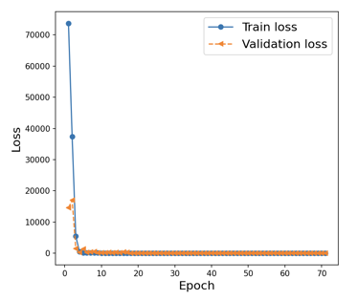
Results: Final Design For Joint Model
Validation Loss (MSE) ~50 for all 30 outputs
Number of Training Epochs is reduced to ~60
Use ReduceLROnPlateau to improve Loss
Incremental improvement to 52nd Position on Kaggle Leaderboard
Notes:
2.67, 2.82 and 52nd in Kaggle

Slide 18
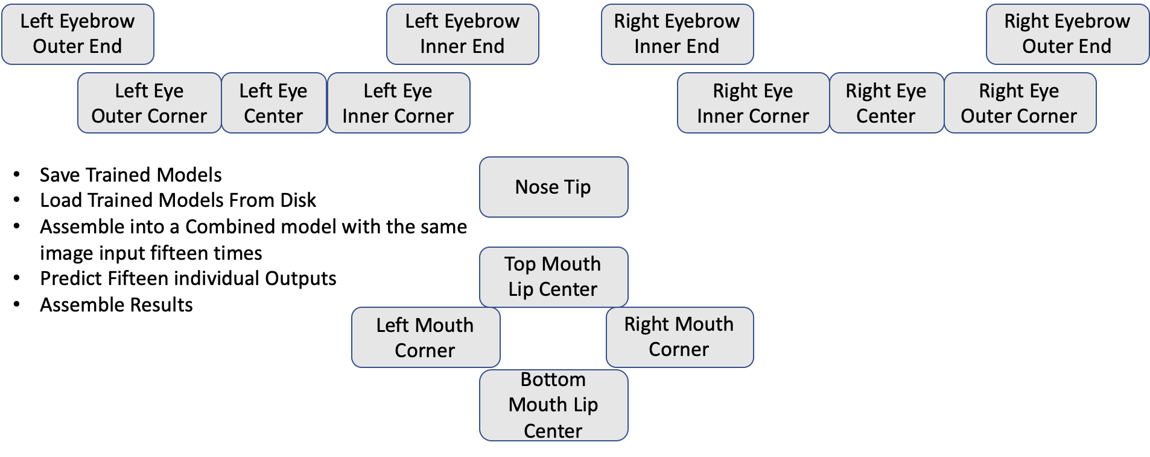
Final Design For Assembled Model
15th on Kaggle Leaderboard
189,382,590

Slide 19
2-Stage Model - Inspiration
Rationale:
Data availability and accuracy
Utilize the relationship between different points
Have first model predict 4 key points that are available in 99.5% of the images
left & right eye center, nose tip, and mouth top center
Use the outputs from 1st Stage model as inputs to the 2nd stage model, to predict the rest 11 key points
Challenges:
How to combine image inputs with numerical inputs?
Even more random decisions to make, and less reference on “best-practices”

Slide 20
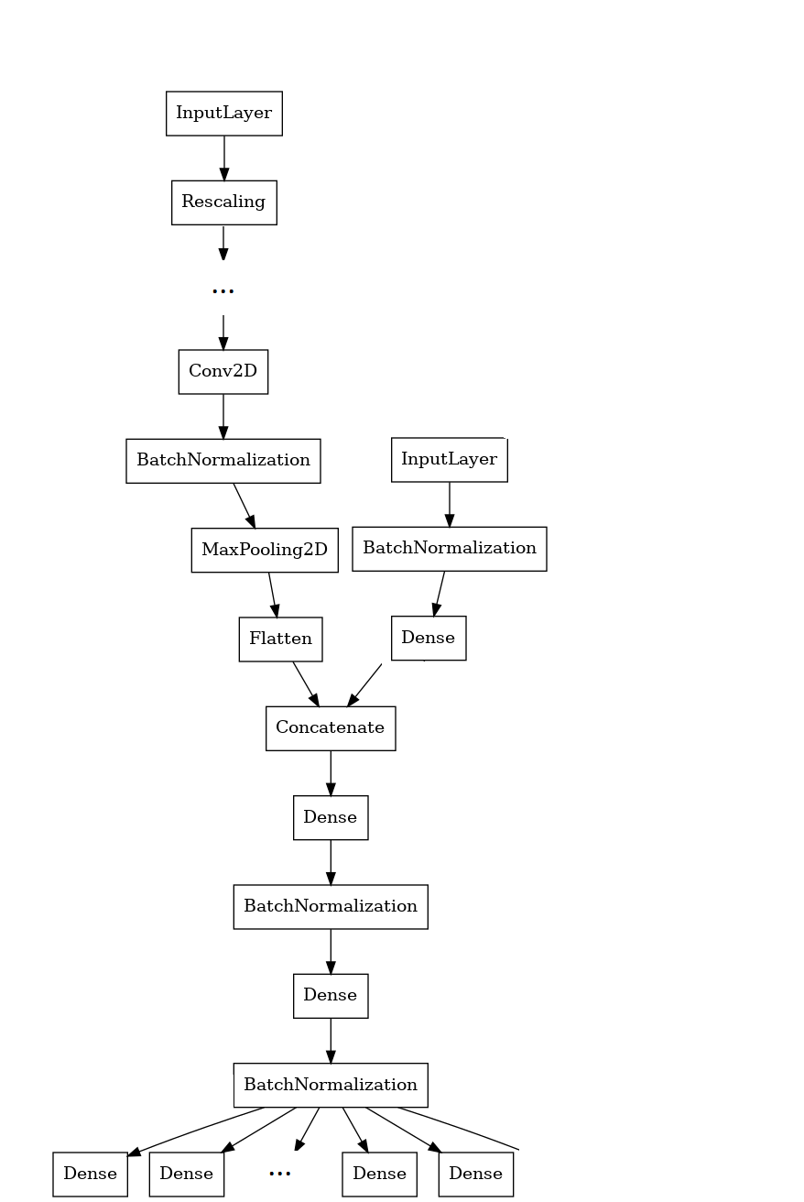
2-Stage Model - Solution
Train the 1st stage CNN model, predict on the data
Have 2 separate input layers into the 2nd stage model
Concatenate the layers right before original Dense layers
Join the 2nd stage predictions with 1st stage predictions

Slide 21
Training & Tuning

Slide 22
Keras Tuner - Let’s do ML in ML way!
Before compile:
Filter/Kernel/stride sizes
# of Conv2Ds layers
# of Conv2D groups
Use DropOut layer?
Increase/Decrease filter?
Activation functions
Kernel initializations
Dense layers
Increase/Decrease Dense layers?
After compile:
Batch sizes
Callback functions
Parameters in callbacks
Notes:
So we looked into some packages available, and used Keras Tuner to systematically tune the model for us
Hyper parameters for us basically includes all the random decisions we made when building and validating the model.
All the hyper parameters are guessed based on empirical knowledge, which may or may not work for our specific problem.
Different hyper parameters will eventually determine the performance of each model, and it is as important as model selection and architecture design.
Some of the initial tuning are done by hand, and it takes a long time to track and compare.
Randomness of the GPU make the problem even worse, so we need to train the same model multiple times to get a stable results

Slide 23
Keras Tuner - Cont.
Different options of hyper parameter tuning:
Random Search
Bayesian Optimization
HyperBand
BOHB
Rationalize the search results:
Empirical Experiences
Problem Complexity
Dataset Size
Notes:
Started with random search - seems like a good default, but ran into the wall because it takes forever. There are x times y times z number of options, and as we try to find a true optimal, this search is taking forever, One run through of our model takes ~15 mins on a normal computer GPU. And I don’t want to burn my GPU, yet (even with the new 4090 coming out).
HyperBand algorithm has a few good attributes:
This is done using a sports championship style bracket, just like the world cup knockouts. The algorithm trains a large number of models for a few epochs and carries forward only the top-performing half of models to the next round.
Rationalize the results:
Different model should be using different hyper parameters: individual model that only predicts nose vs the joint model that predict all 15 keypoints
Matches the research that Ed did on VGG models on the most part, with some tweaks here and there to get better performance
BOHB is a combination of HyperBand and BO, which seems to be the state of the art optimization - didn’t get a chance to try

Slide 24
Results

Slide 25
Results from Final Models
Model | Score (in pixels) | Ranking | Notes
KNN | 4.20 | 143 th | Baseline: KNN model
Joint | 2.85 | 55 th | CNN based, predict all 15 key points together
Assembled | 1.89 | 15 th | CNN based, predict 15 points in 15 models, and assemble
2-stage | 1.67 | 7 th | CNN based, predict 4 points in 1st stage CNN model, then use the outputs as inputs to the 2nd stage model
Notes:
Discuss reason for why / why not each model might have worked, and what we expect each model would have learned
Critics on each of the model:
KNN is just a best guess, no learning
Joint seems an overshot by simply trying to do everything together - this should really be the baseline maybe?
Assembled makes sense, given each feature eventually are different
takes a lot of resources to train, and also heavy when using - given so many models.
Also ignores the relationship between different keypoints
2-stage is our favourite one, as a middle ground between joint and assembled model, and added in our human understanding.

Slide 26
Improvements and Future Thoughts
Better data augmentation and pre-processing
Further slice and dice the features into sub-models
Even more intensive tuning
Try other more advanced models / features and mix them into our model
Just for the competition:
Better handling of missing features on the model, especially on test data
Avoid big mistakes that carry a lot of weight in a RMSE loss

Slide 27
Replicate Our Results
Get The Docker Container at Docker Hub tensorflow:2.11.0-gpu-jupyter
Download Trained Models from sync.com
Get the Code from Github (Publicly Available after 12/10/2022)

Slide 28
Questions?

